Slide 2
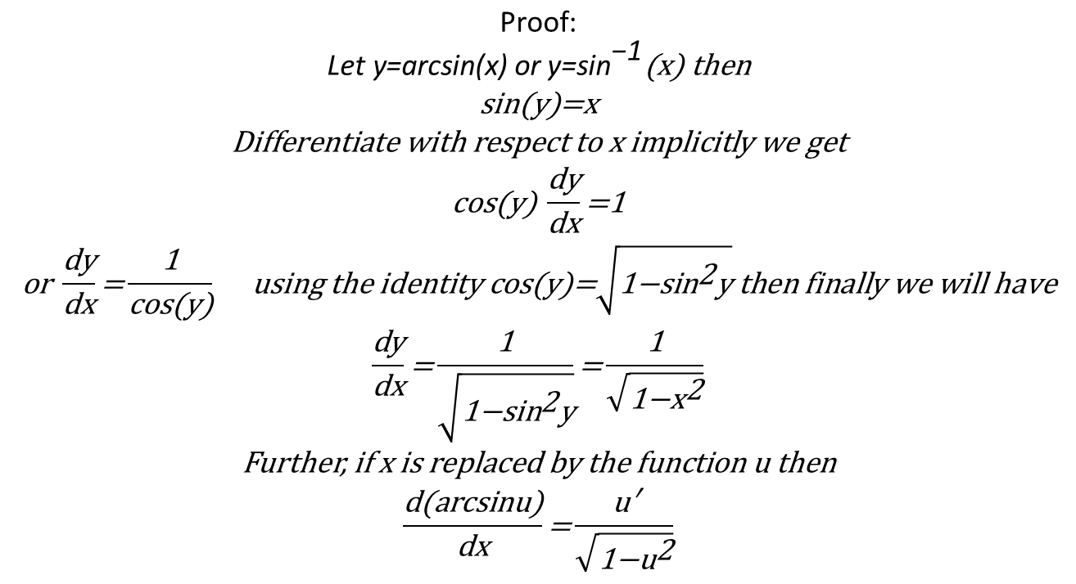
$$\begin{matrix}\text{Proof}\text{:} \\ {\text{Let} \text{y}\text{=}\text{arcsin}\text{(}\text{x}\text{) }\text{or} \text{y}\text{=}\text{sin}}^{\text{−1}}\text{(}\text{x}\text{) }\text{then} \\ \text{sin}\text{(}\text{y}\text{)=}\text{x} \\ \text{Differentiate} \text{with} \text{respect} \text{to} \text{x} \text{implicitly} \text{we} \text{get} \\ \text{cos}\text{(}\text{y}\text{) }\frac{\text{dy}}{\text{dx}}\text{=1} \\ \text{or} \frac{\text{dy}}{\text{dx}}\text{=}\frac{\text{1}}{\text{cos}\text{(}\text{y}\text{)}} \text{using} \text{the} \text{identity} \text{cos}\text{(}\text{y}\text{)=}\sqrt{{\text{1−}\text{sin}}^{\text{2}}\text{y}} \text{then} \text{finally} \text{we} \text{will} \text{have} \\ \frac{\text{dy}}{\text{dx}}\text{=}\frac{\text{1}}{\sqrt{{\text{1−}\text{sin}}^{\text{2}}\text{y}}}\text{=}\frac{\text{1}}{\sqrt{{\text{1−}\text{x}}^{\text{2}}}} \\ \text{Further}\text{, }\text{if} \text{x} \text{is} \text{replaced} \text{by} \text{the} \text{function} \text{u} \text{then} \\ \frac{\text{d}\text{(}\text{arcsinu}\text{)}}{\text{dx}}\text{=}\frac{\text{u}\text{′}}{\sqrt{{\text{1−}\text{u}}^{\text{2}}}}\end{matrix}$$
Also, the remaining inverse trigonometric can be proved in the similar manner

